Slide 1
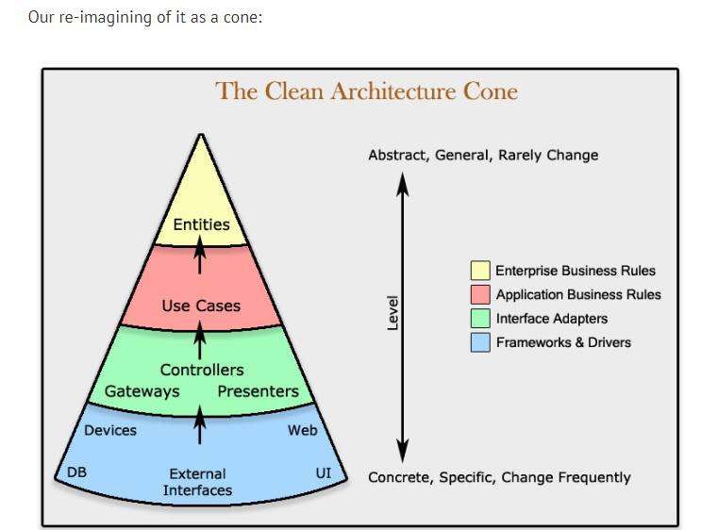
Clean Architecture review and differences
Clean Architecture achieves framework independence by placing the business rules and application-specific rules at the center of the design and treating the frameworks as mere details that live on the outer layers of the architecture.
This ensures that the core business logic remains unaffected by changes in external systems and frameworks.

Slide 2
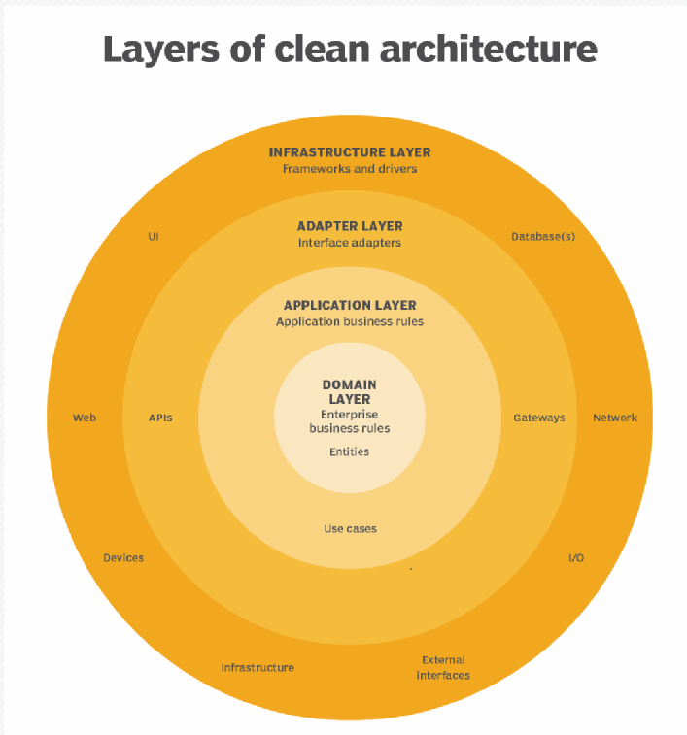

Slide 3


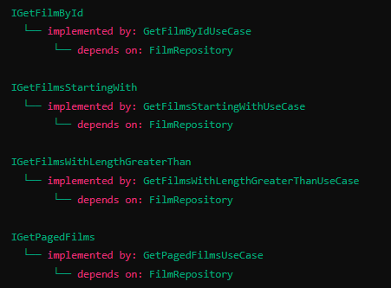
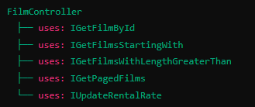
Class diagram
Domain Layer:
Model:
Actor
Film
Repository:
FilmRepository
Application Layer:
Use Cases:
GetFilmByIdUseCase (implements IGetFilmById)
GetFilmsStartingWithUseCase (implements IGetFilmsStartingWith)
GetFilmsWithLengthGreaterThanUseCase (implements IGetFilmsWithLengthGreaterThan)
GetPagedFilmsUseCase (implements IGetPagedFilms)
UpdateRentalRateUseCase (implements IUpdateRentalRate)
Interfaces:
IGetFilmById
IGetFilmsStartingWith
IGetFilmsWithLengthGreaterThan
IGetPagedFilms
IUpdateRentalRate
Adapters Layer:
Controllers:
FilmController
Gateways:
FilmDataSource
PanacheFilmDataSource

Slide 4
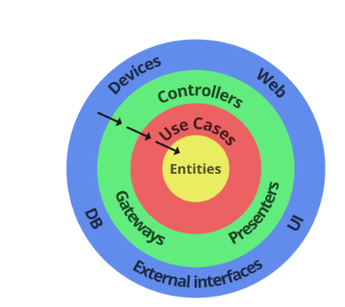
Clean Architecture, dependencies point inwards (from outer layers to inner layers), and the inner layers (Entities and Use Cases) are not aware of the outer layers (Controllers, web, DB/Data Sources). This results in a decoupled, testable, and independent system.
PanacheFilmDataSource implements FilmDataSource and FilmRepository, acting as an adapter between the database and the use cases.
The use cases don't know about PanacheFilmDataSource; they only know about the FilmDataSource and FilmRepository interfaces.
This means I can change PanacheFilmDataSource without affecting the use cases, as long as the new class implements the same interfaces.
The high-level module (GetFilmByIdUseCase) does not depend directly on the low-level module (PanacheFilmDataSource); both depend on abstractions (FilmDataSource interface).
This decoupling makes the system more flexible and maintainable. For example, we can change the database or switch from a web interface to a desktop interface without affecting the use cases or entities. It also makes it easier to test the business rules independently of the external elements.

Slide 5
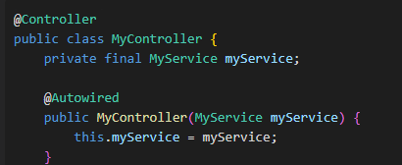
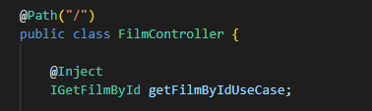
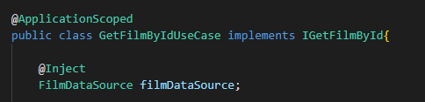
Differences
In Spring MVC:
The Controller depends on the Service(contains business logic).
The Service depends on the Repository.
The Repository depends on the Database.
This means that changes in the Repository can affect the Service, and changes in the Service can affect the Controller. The lower layers are not isolated from changes in the higher layers.
In Clean Architecture:
The outer layers (Controllers, Presenters, Data Sources) depend on the inner layers (Use Cases, Entities), but not the other way around.
The Use Cases and Entities do not depend on anything. They define interfaces that the outer layers implement.
This means that you can change the outer layers without affecting the inner layers. For example, you can change the database technology (and hence the Data Source) without changing the Use Cases or Entities. This is because the Use Cases and Entities only know about the interfaces, not the implementations.

Slide 6
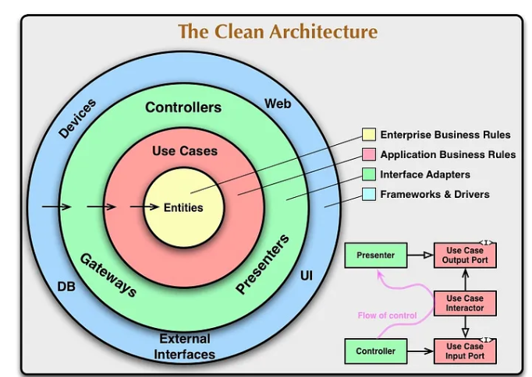
Differences Continued..
In Clean Architecture:
Structure: Consists of core entities, useCases /interactors, interface adapters, and infrastructure.
Dependency Direction: Follows the Dependency Rule, where dependencies point inward toward the core business logic.
Separation of Concerns: Strict separation between different layers, with a strong emphasis on keeping the business logic independent of external frameworks and technologies.
Framework Independence: Core business logic (entities and use cases) is independent of any specific framework.
The FilmDataSource interface is implemented by classes like PanacheFilmRepository and NewDBFilmRepository, which do depend on specific frameworks (Panache and NewDB, respectively). But these implementation details are hidden from the use case classes and the entity classes, which only depend on the FilmDataSource interface, not on any specific implementation of this interface.
In Spring MVC:
Structure: Typically consists of presentation, business logic, and data access layers.
Dependency Direction: Dependencies often flow from the top layer (presentation) to the bottom layer (data access).
Separation of Concerns: Clear separation between different layers, but often, the higher layers are tightly coupled with lower layers.
Framework Dependence: Layers may be tightly coupled with specific frameworks or technologies.
Flexibility: Changes in one layer can ripple through others, especially if business logic is intermixed with data access logic.

Slide 7


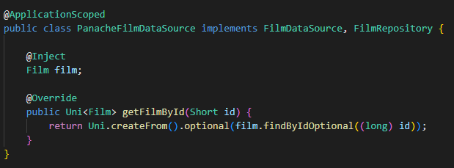
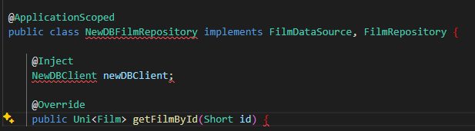
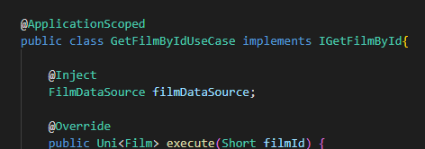

How would I have changed the DB?
in use case class GetFilmByIdUseCase I would have inject NewDBFilmRepository instead of PanacheFilmRepository:

Slide 8
Uncle bob says:
Uncle Bob emphasizes 4 main points about Clean Architecture :
Independent of Frameworks. The architecture does not depend on the existence of some library of feature laden software. This allows you to use such frameworks as tools, rather than having to cram your system into their limited constraints.
Testable. The business rules can be tested without the UI, Database, Web Server, or any other external element.
Independent of UI. The UI can change easily, without changing the rest of the system. A Web UI could be replaced with a console UI, for example, without changing the business rules.
Independent of Database. You can swap out Oracle or SQL Server, for Mongo, BigTable, CouchDB, or something else. Your business rules are not bound to the database.
Independent of any external agency. In fact your business rules simply don’t know anything at all about the outside world.
Clean Architecture says : It’s all about Dependency Rule !The inner circle is not allowed to know anything about the outer circle. Even, Uncle Bob says more :

